Slide 1
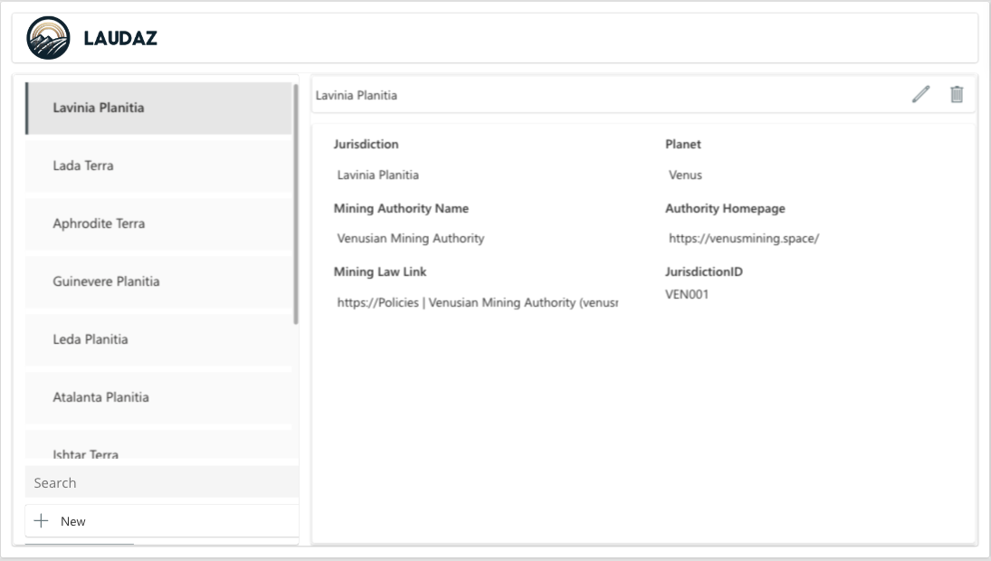
Calculted wieghted total risk
Button for existing copilot
Card 3 overlays left panel
Screen 1 – Landing Screen
Task Info
Card 2
Links to screen 2 Info Screen
Tasks
8 or 31 complete
Colour determined by the risk score
Create new task in pop out card 1
CP
User
+
8/31
I
Search
Filter
Delete selected task with popout confirmation
Are You Sure
Yes No
Filtered by default to only Jurisdictions
with tasks
Button under active to see inactive jurisdictions
- Category
15
Task Description
Status
I
Owner
5
Task Description
Status
Owner
I
10
+ Category 2
Main list of tasks should be hiarchical and each category should expand to show the tasks in the category 0 similar to this example
Status field is drop down list
Owner field is drop down list
+ Category 3
+ Category 4
Card for Copilot overlays here when CP putton is pressed
When owner is set it triggers a notification and planner task flow
New Jurisdiction Screen 3

Slide 2



Add Shrepoint Link
Add Teams Group
Add Planner link
CP card 3 over lays left panel
Screen 2
Navigate back to screen 1
CP
User
8/31
Hyperlink
To Active
Webpage
Filtered by default to only active Jurisdictions
Tenement Data
Exploration (EL) – g1 p1
Mining (ML) – 2
Flagged For Surrender – 1
Stakholder List
User 1 – Title
User 2 - Title
I
I
Card for Copilot overlays here when CP putton is pressed
Stakholder
Info
Card 4 pop out to show stakholder info
List of stakeholders

Slide 3
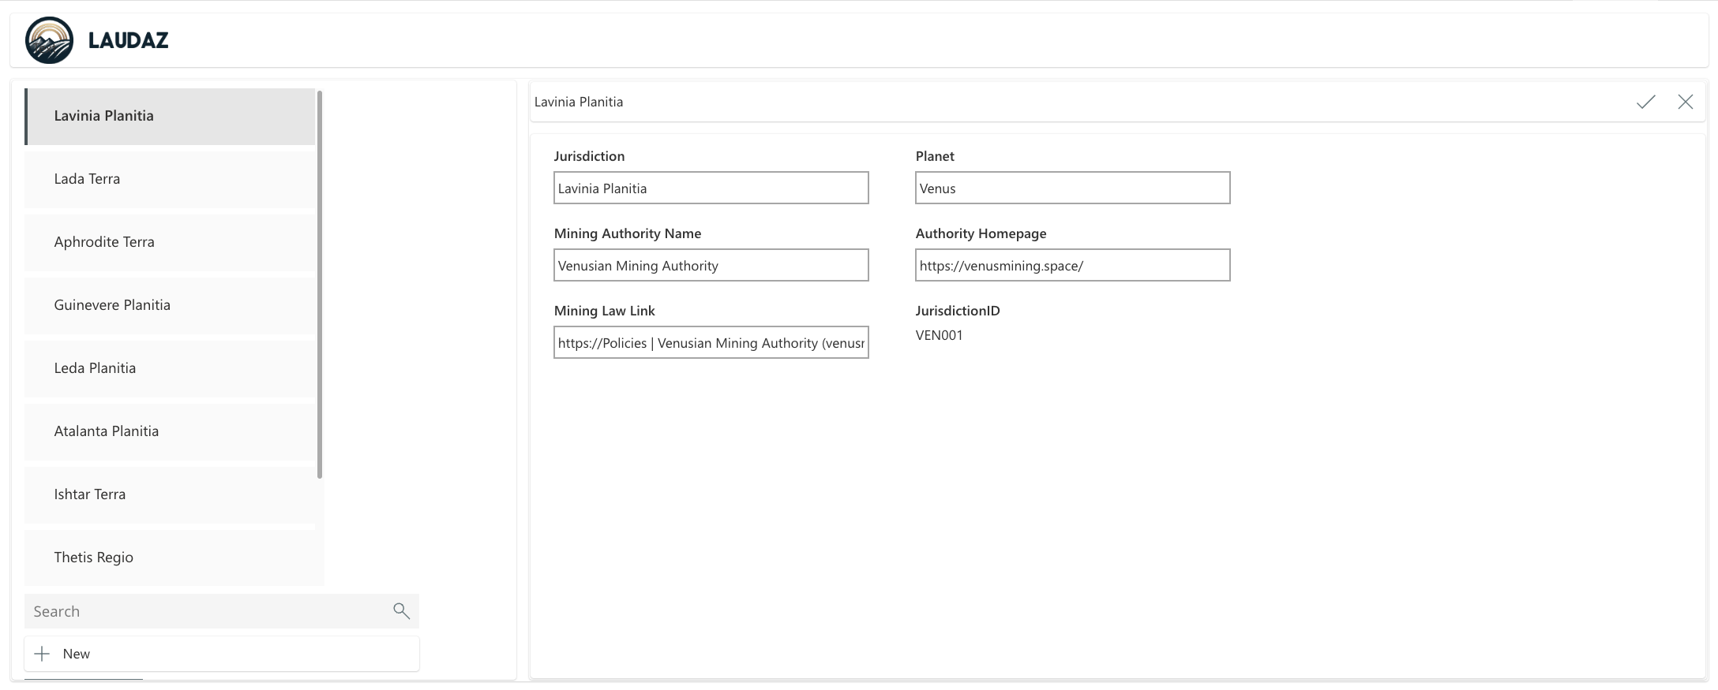
Screen 3 – Enter New Jurisdicltion Form
Close Card
Pop for Save
or don’t Save
Button To Copy All Tasks from
Another Jurisdiction
Button To Apply Standard Tasks

Slide 4
Card 1 – New Task
Close Card
Pop for Save
or don’t Save
Done
Category* |  | Task Description*
Choice Field |  | Multiple Line text
Priority* |  | Risk*
Choice Field |  | Choice Field
Status* |  | Owner
Choice Field |  | Lookup Stakholder Table
When owner is set it ON SAVE trigger a notification and planner task flow
Notes (Multiple Line text)

Slide 5
Card 2 – Task Info
Close Card
Pop for Save
or don’t Save
Done
Category* |  | Task Description*
Choice Field |  | Multiple Line text
Priority* |  | Risk*
Choice Field |  | Choice Field
Status* |  | Owner
Choice Field |  | Lookup Stakholder Table
When owner is set it triggers a notification and planner task flow
Notes (Multiple Line text)

Slide 6
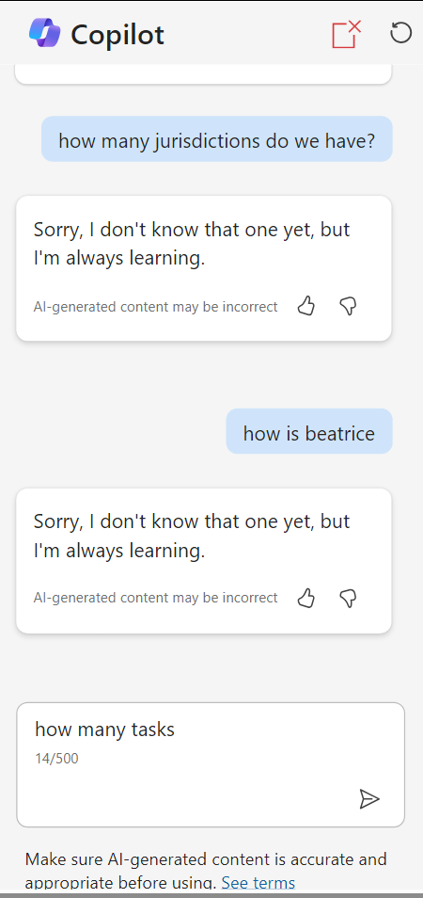
Card 3 – Copilot
Close copilot card
X

Slide 7
Card 4 – Stakholder Info
Close Card
Pop for Save
or don’t Save
Done
Name |  | Company
Text |  | Text
Role |  | Department
Text |  | Text
Projects |  | Email
List |  | Lookup Stakholder Table
Manager Text
Stakholder Analysis Notes (Multiple Line text)

